Slide 1
Experiments
Instructor: Davide Proserpio

Slide 2
Why We Run Experiments
Marketers constantly ask: “Did my action cause a change?”
But Correlation ≠ causation.

Slide 3
Why We Run Experiments
Marketers constantly ask: “Did my action cause a change?”
But Correlation ≠ causation…
In general, what can we learn from a significant correlation?
“These two variables likely move together." Anything more requires assumptions.

Slide 4
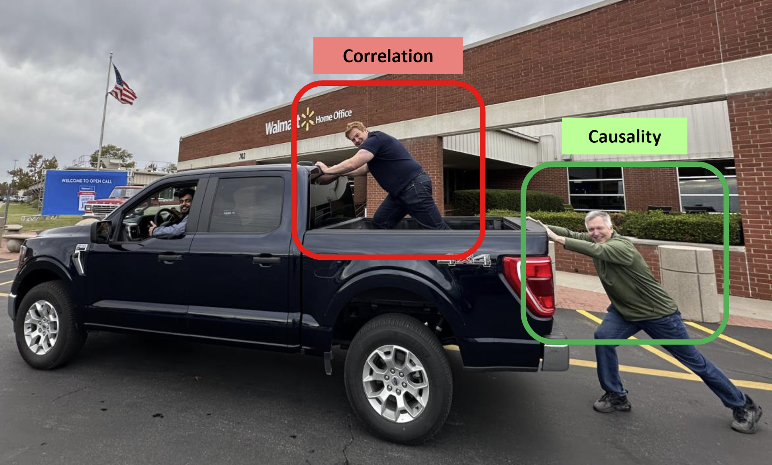
Correlation ≠ causation

Slide 5
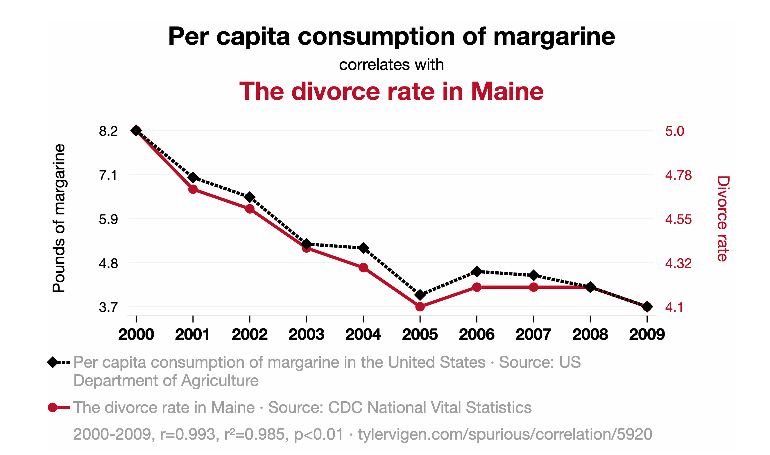
Correlation ≠ causation

Slide 6
Correlation ≠ causation
Classic misleading correlations
Commuters carrying umbrellas and rain
Forward-looking behavior
Kids receiving tutoring and grades
Reverse causality / selection bias
Ice cream sales and drowning deaths
Unobserved confounds

Slide 7
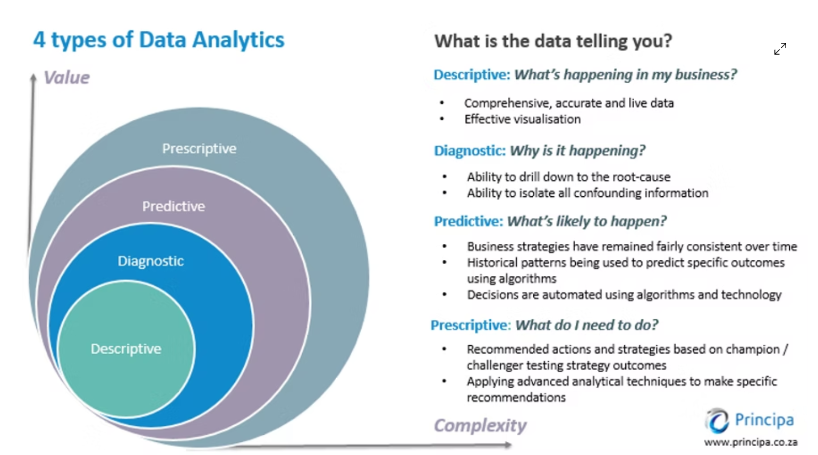
Why causality matters?

Slide 8
Why causality matters?
Correlations are descriptive analytics (“facts”)
Causality matters most for diagnostic and prescriptive analytics
Causality can help build predictive models, but correlations suffice most of the time for predictions

Slide 9
Why we need experiments: The Counterfactual Problem
For each unit, we observe only one outcome:
what happened with the treatment, or without, not both.
The case we don't observe is called the "counterfactual"
This is a missing-data problem that we cannot resolve. We only have one reality
A significant reason we build models is to compensate for missing data.
Randomization creates comparable groups → approximates missing world.

Slide 10
The Logic of an Experiment
Compare treated vs control units.
Everything else held constant through randomization.
Any average difference = causal effect.

Slide 11
Anatomy of a Randomized Experiment
Element | Description
Population | Users, customers, products
Treatment | Message, ad, feature, policy
Randomization | 50/50 split or stratified design
Outcome | Click, purchase, satisfaction, etc.

Slide 12
Randomization in Practice
Unit of randomization matters:
user, session, region, campaign, etc.
Always check unit balance: are treated/control groups similar?
If not, the experiment may be biased.

Slide 13
A/B Testing: Experiments in Product and Marketing
A/B test = simplest form of an RCT.
Test two versions (A and B) differing in one element.
Measure difference in outcomes → decide which performs better.
Used for web design, pricing, ad creatives, and recommendations.
Substack example

Slide 14
Estimate treatment effect
Observed differences can arise by chance.
Use hypothesis testing to judge if effect is real.
Report confidence intervals or p-values.
Small samples → noisy results.

Slide 15
Common Mistakes in A/B Testing
Peeking early (stopping when results look good)
Running time too short → low power
Multiple tests → false positives
Spillovers between users
Focusing on statistical significance, not business value

Slide 16
Ads Measurements

Slide 17
Ads Measurements
Ad measurement refers to the set of methods used to quantify the effect of advertising exposure on desired outcomes — such as awareness, clicks, conversions, or sales — across channels, audiences, and time.
Advertising measurement is hard because ad effects depend on ad content, context, timing, targeting, current market conditions, past advertising & past outcomes
Advertising measurement is expensive, so must directly inform firm choices
We have to know how measurements will inform next steps, else measurement is wasting money

Slide 18
What do we measure?
Often, Return on Ad Spend (ROAS) or Incremental ROAS (iROAS)):
ROAS = (Revenue attributed to ads – Ad Spend) / Ad Spend
ROAS != iROAS because attribution is usually correlational

Slide 19
Attribution vs. Incrementality
Concept | Main Question | What It Measures | Data Basis | Typical Output | Core Limitation
Attribution | “Which channel, ad, or touchpoint gets credit for the conversion?” | Allocation of credit among exposures | Observational data (click paths, impressions) | % contribution per channel (e.g., search 40%, display 30%, social 30%) | Correlational: cannot tell if ads caused the conversion
Incrementality | “How much of the observed behavior would have happened without the ad?” | True causal lift — incremental effect | Experimental or quasi-experimental data (holdout tests, ghost ads, geo experiments) | Lift %, incremental conversions, iROAS | Requires randomization or strong identification design

Slide 20
Heuristic Attribution Models
Last-touch: credit to last channel before conversion.
First-touch: credit to first interaction.
Linear / Time-decay: spread credit across touchpoints.
Easy, but not causal → can double-count effects.

Slide 21
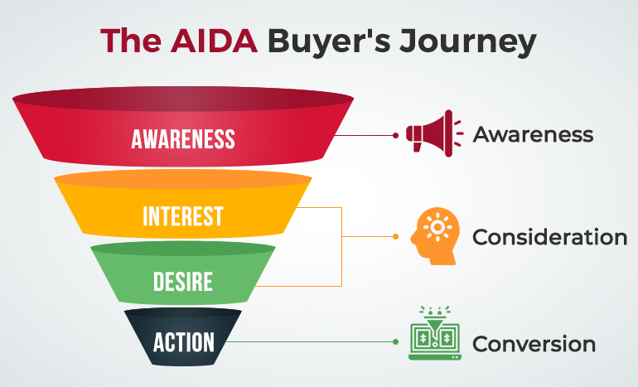
How can we measure ads incrementality?
RCTs can aid ad measurements
They are very useful to measure the incremental (causal) impact of ads on outcomes.
Note that it is much easier to measure outcomes for campaigns designed to stimulate short-run responses (e.g., sales) rather than long-run

Slide 22
Incrementality Testing in Ads
Run an ad holdout experiment:
Randomly suppress ads for a control group.
Compare outcomes → estimate incremental lift.

Slide 23
The “Ghost Ads” Design
Serve ads as if everyone participated, but only some see them.
Randomization integrated into ad auction logic.
Ensures fair control → avoids targeting bias.
Used by Amazon, Meta, and Google.

Slide 24
Geo-Split Test
Randomize ad exposure across markets (cities/regions).
Measure aggregate lift.
Useful for TV, brand, or offline campaigns.
Requires large samples and market comparability.

Slide 25
Practical Takeaways
Randomization = best path to causality.
A/B testing applies same logic to product and ad decisions.
Attribution ≠ incrementality — don’t confuse credit with causation.
Experiments should inform budget allocation, not replace it.

